Slide 1
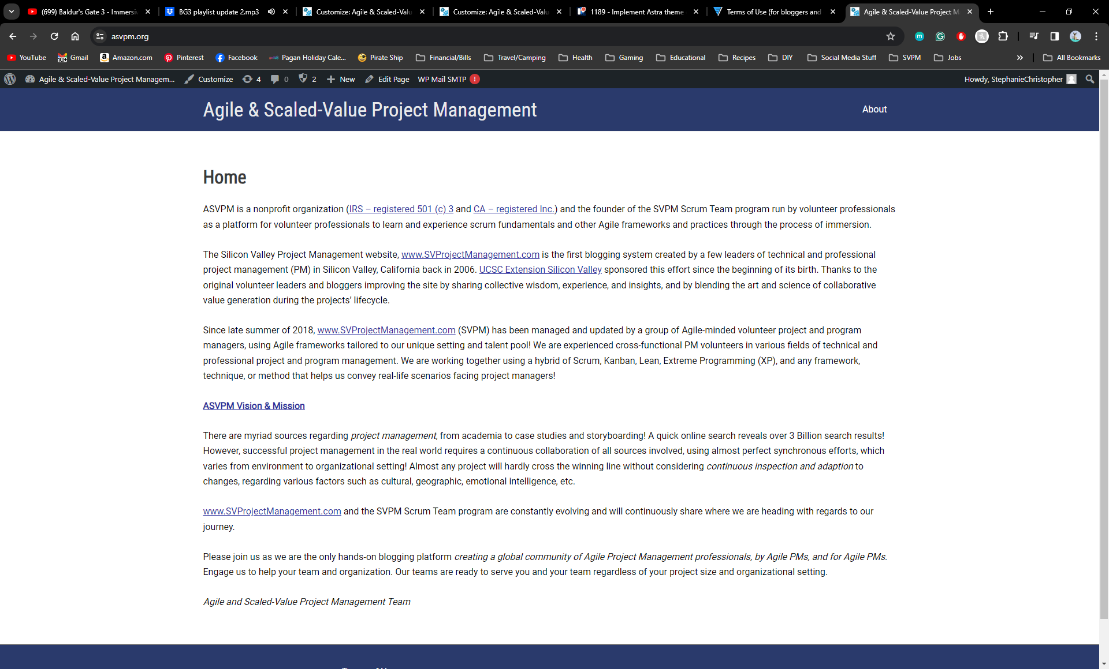
PBI 1189
Implement Astra theme on the ASVPM site & Implement header and footer styles from SVPM page to ASVPM page

Slide 2
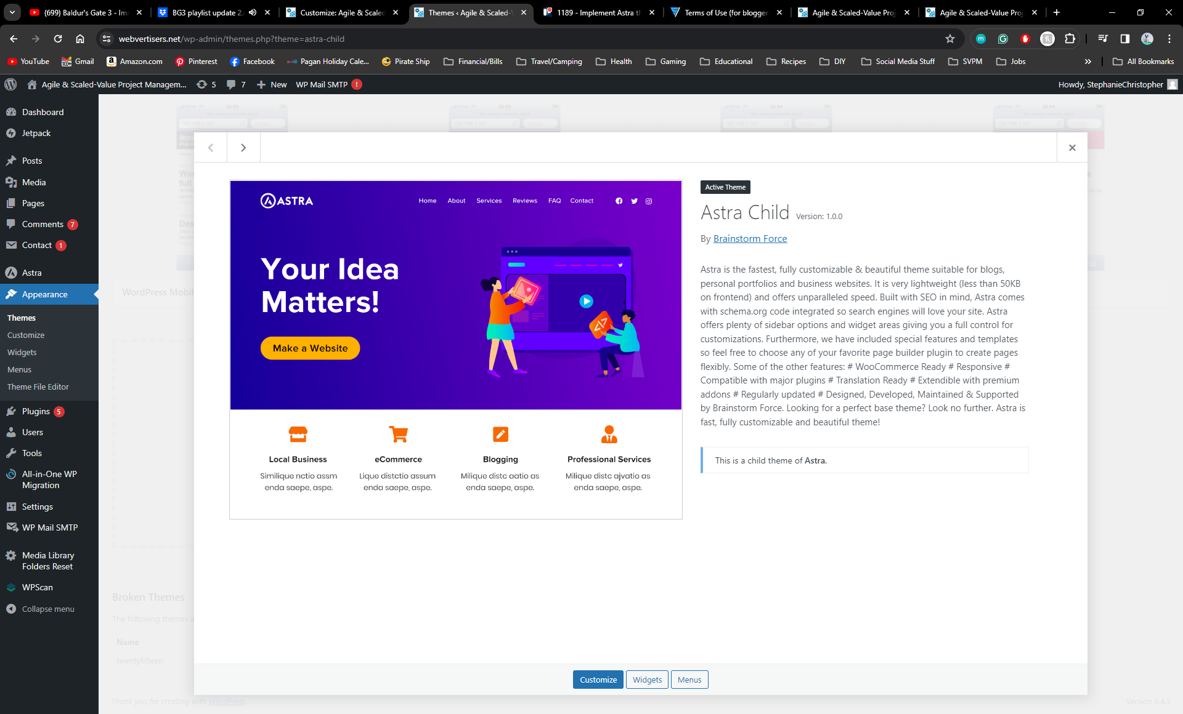
Switch Theme to Astra (Child)
The ASVPM site is not currently using the Astra theme. The sponsors would like the themes to be consistent across both sites for ease of replication/updates. Visitors should also feel like the site are related to the same organization.

Slide 3
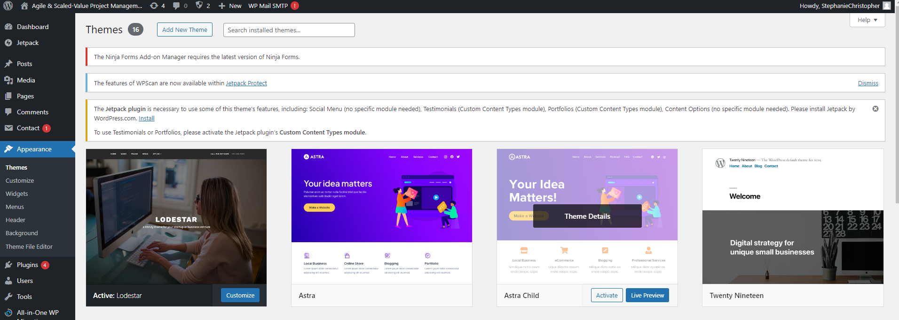
Switch Theme to Astra (Child)
Just Click Activate!

Slide 4

Customizing The Appearance
As a visitor to the ASVPM site, I want to feel that there is consistency across the different parts of the same organization, so that navigation and feel are similar and not disjointed.

Slide 5
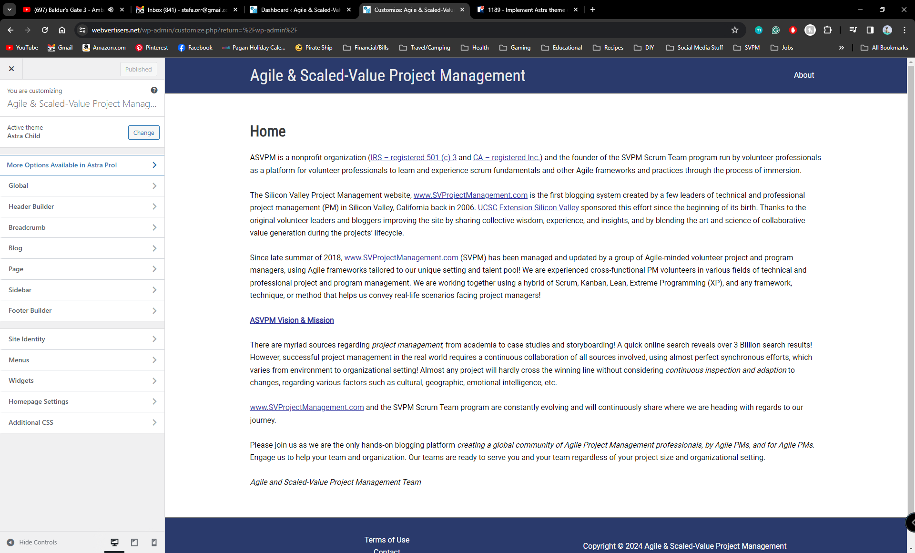
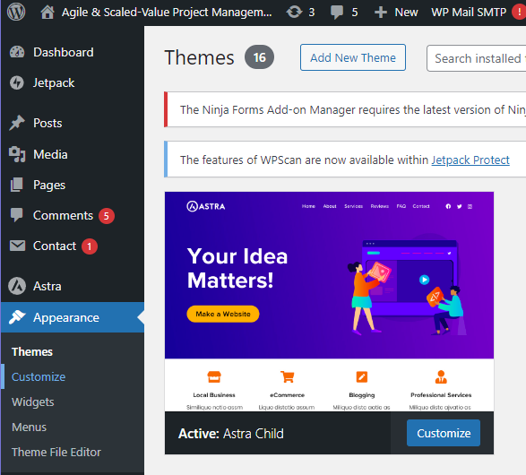
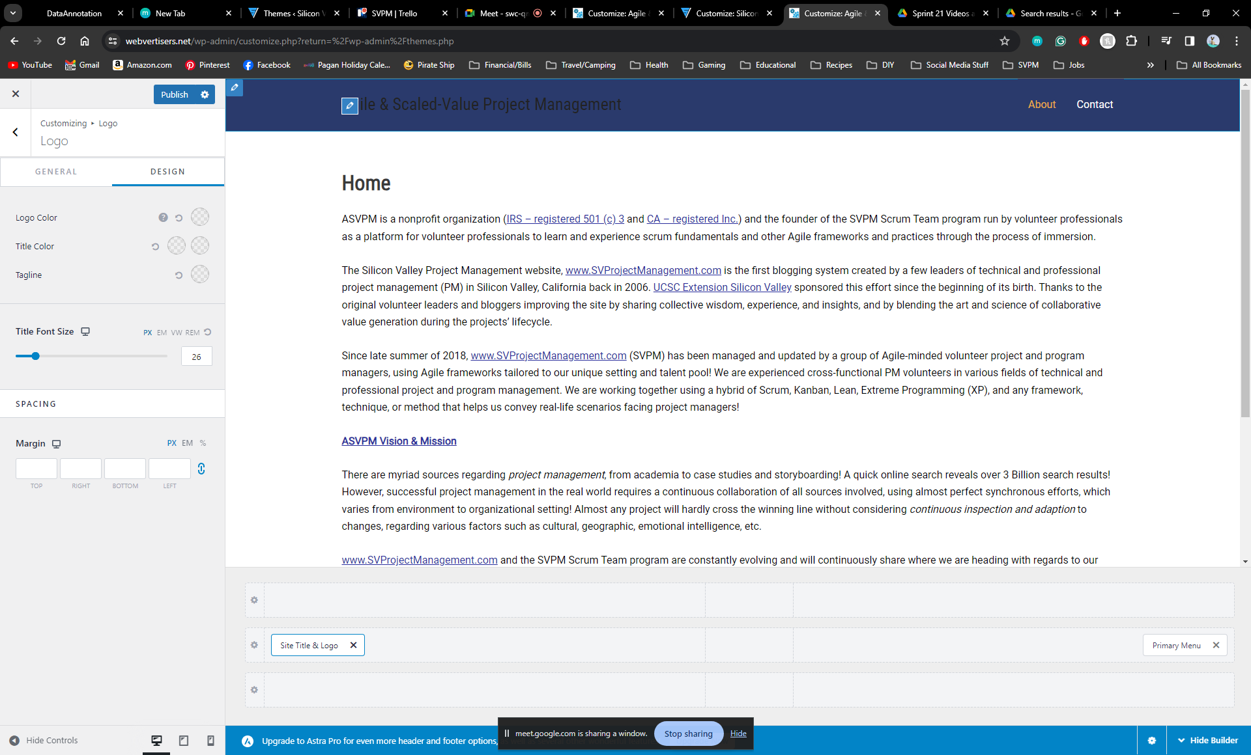
Once the theme is switched, select Customize under the Appearance section
Once you have selected customize you will go into a live editor
You should see a menu like this one:
You can make your selections by using the menu to navigate to the header or footer
You can also hover over the header, footer, or specific section you want to edit and click the edit button that pops up
I prefer to use the click and edit

Slide 6
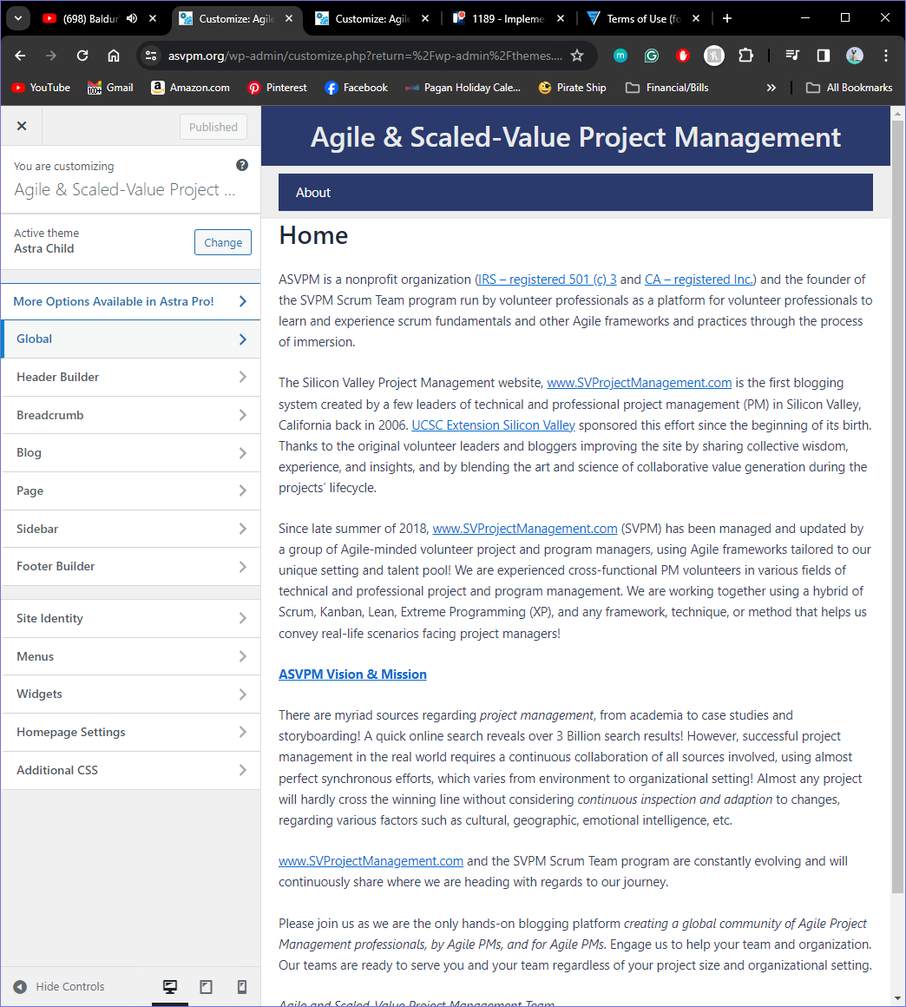
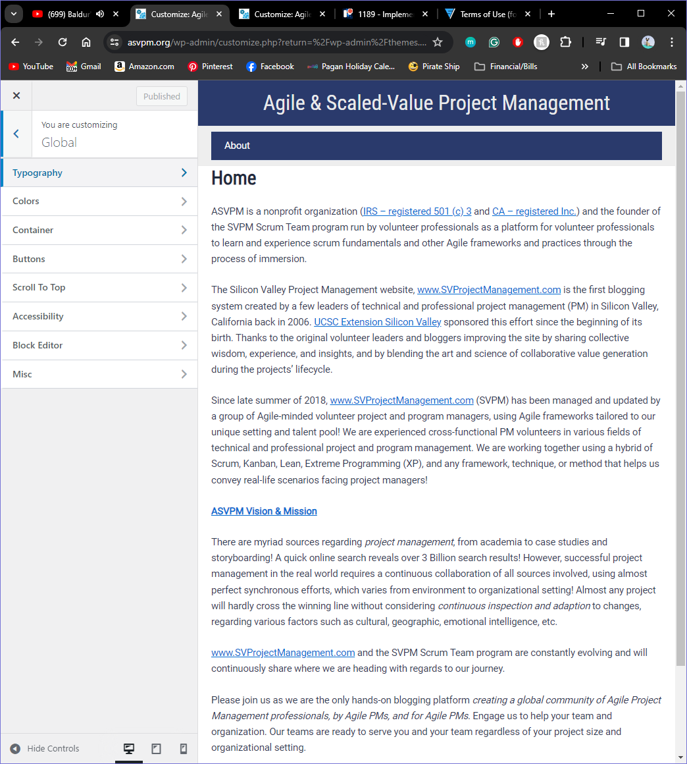
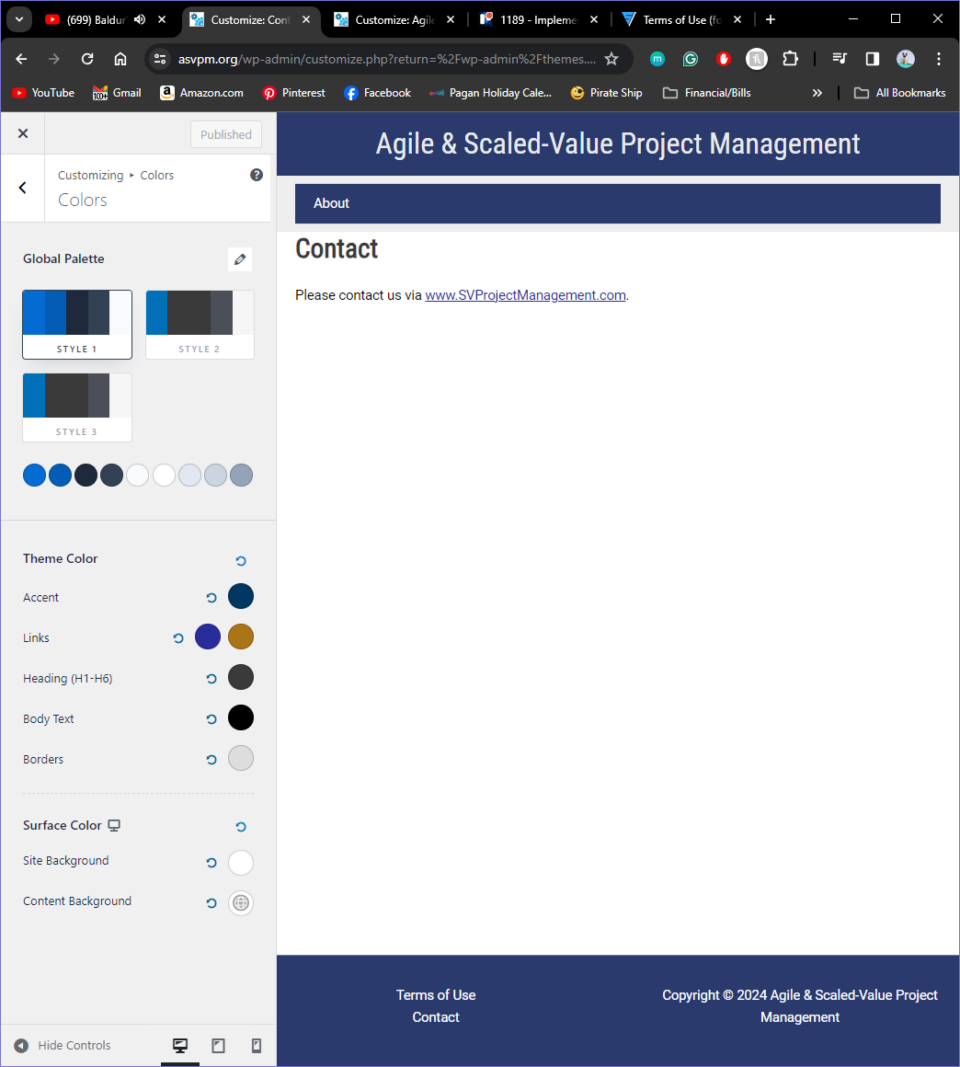
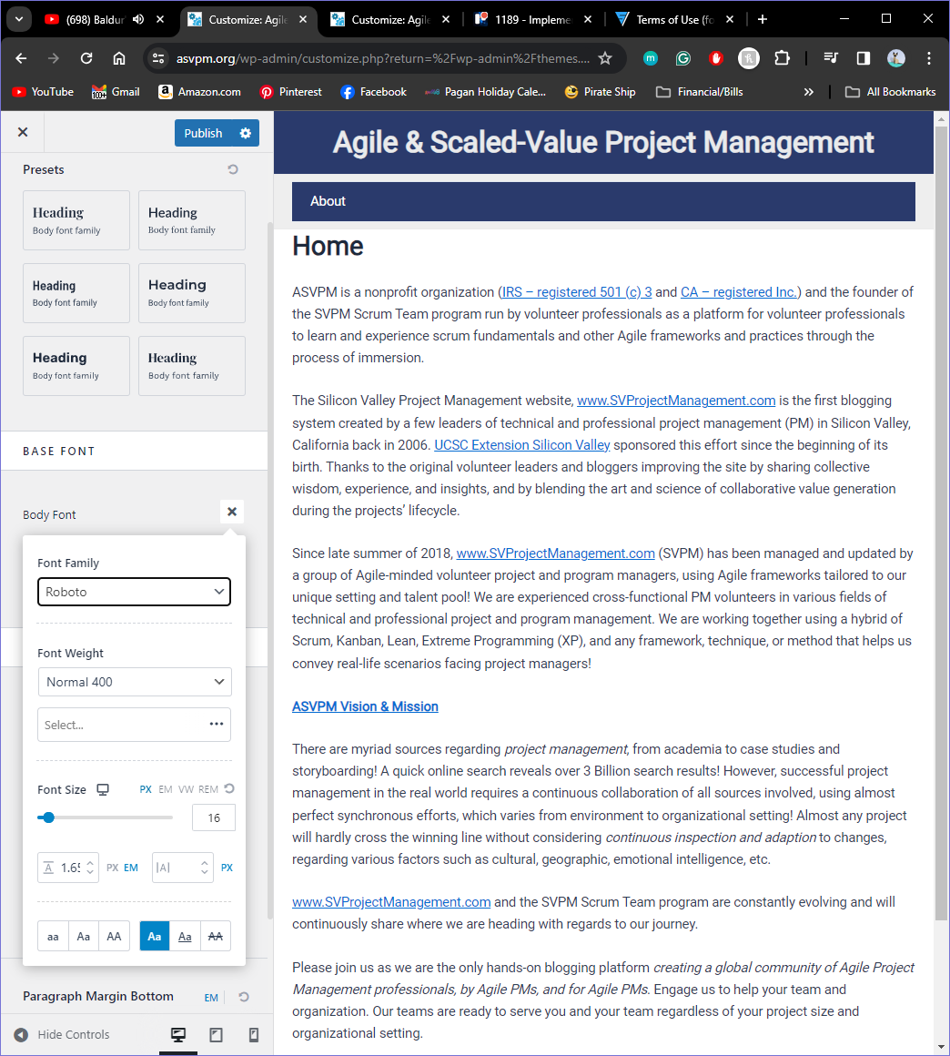
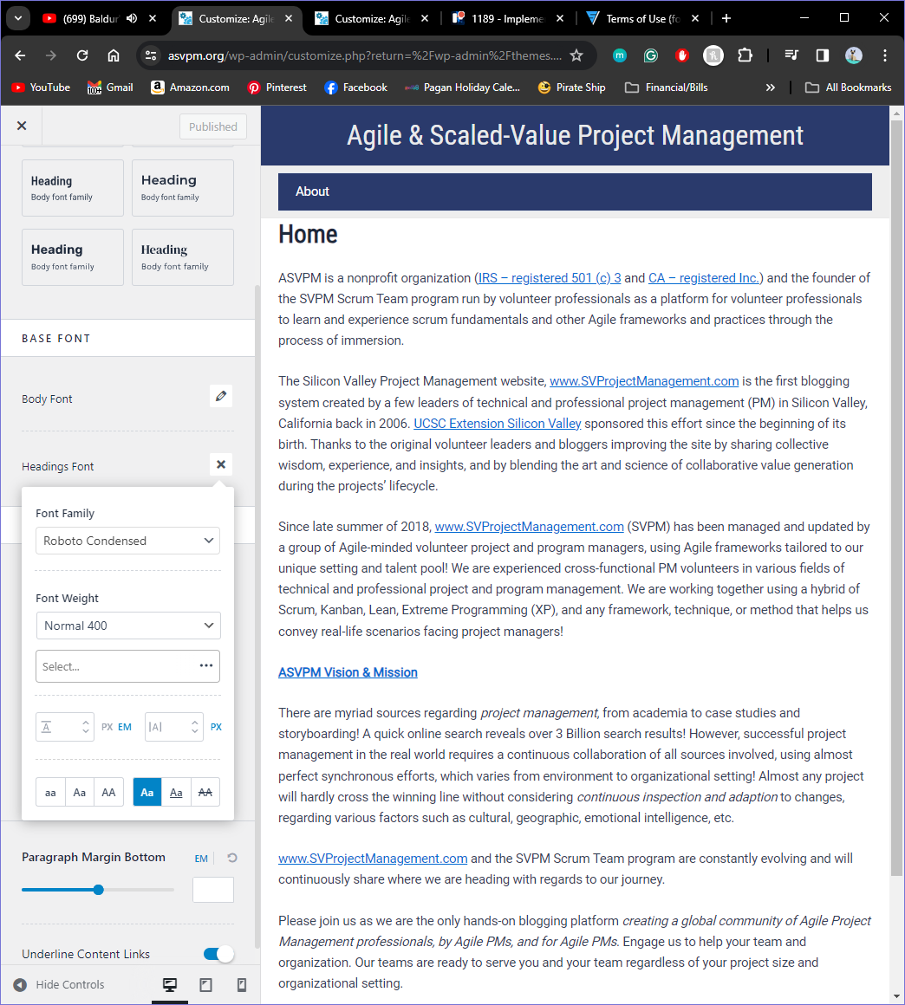
Adjusting Site Typography & Colors
From the Menu Select Global > Colors
From the Menu Select Global > Typography
Global Palette Should be set to style 1
Body Font:
Font Family: Roboto
Headings Font:
Font Family: Roboto Condensed
Font Weight: Normal 400
Theme Color
Accent: 003862
Links: Normal - 292D9C/ Hover - AB7416
Heading: 3A3A3A
Body Text: 000000
Borders: DDDDDD
Surface Color
Site Background: FFFFFF
Content Background: FFFFFF

Slide 7
Header
Duplicate the header/footer formatting from the SVPM site to the ASVPM site. There is currently a generic footer and header that needs to be replaced.
Navigation for the site should be user friendly and, in the header, similar to SVPM.

Slide 8
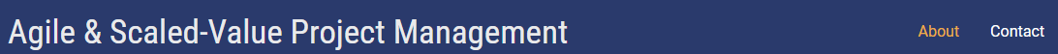
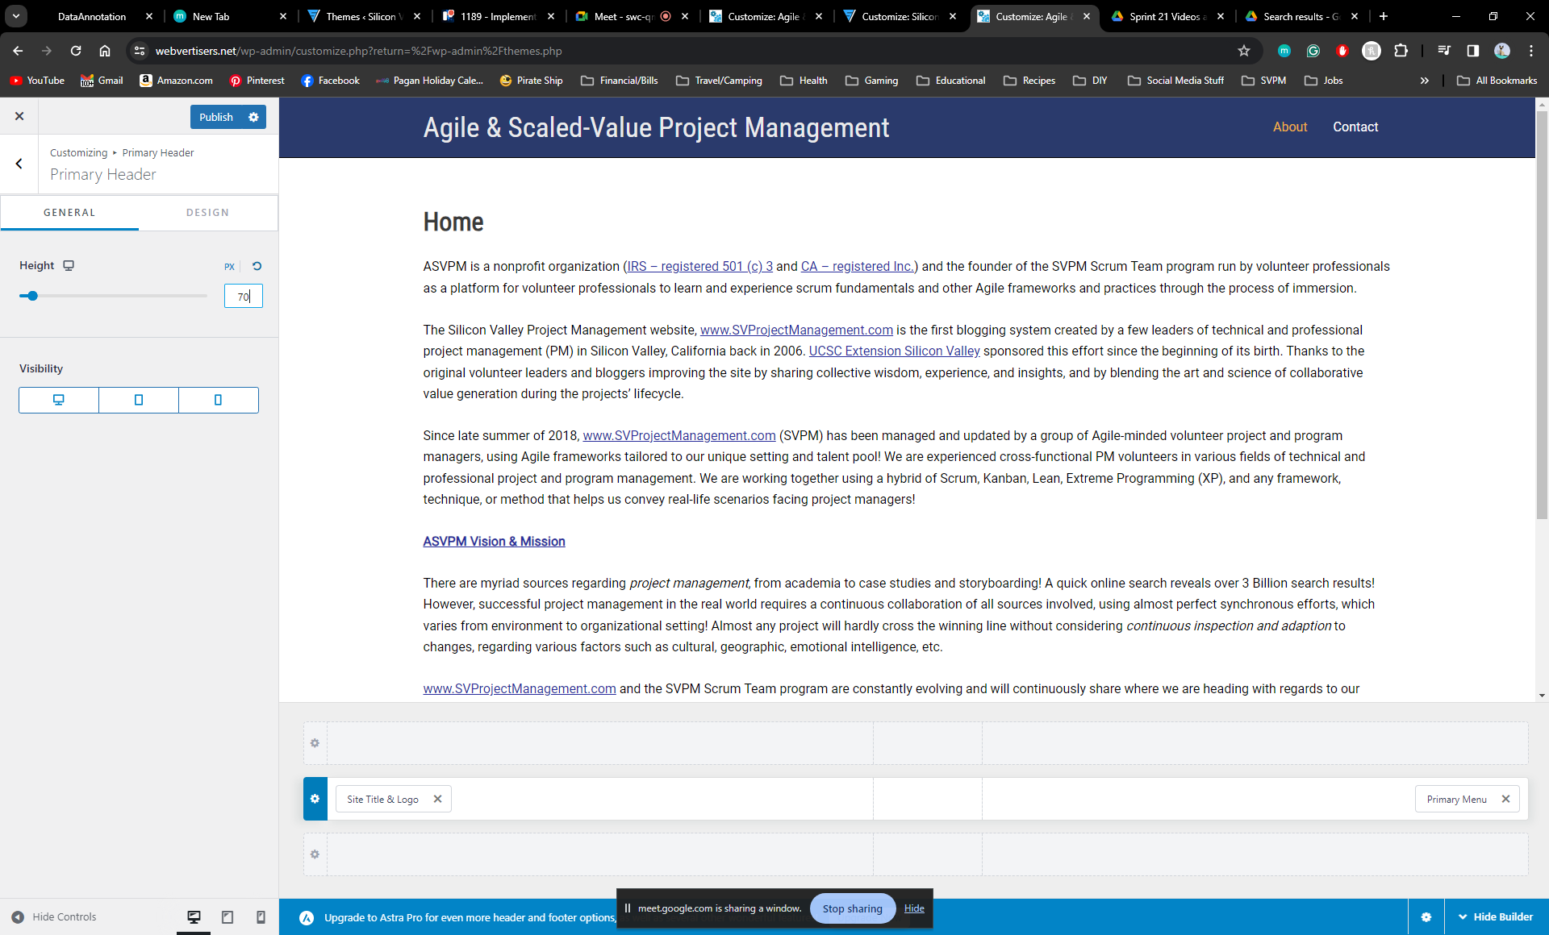
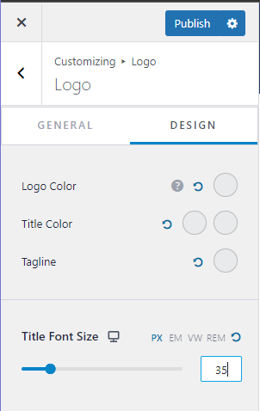
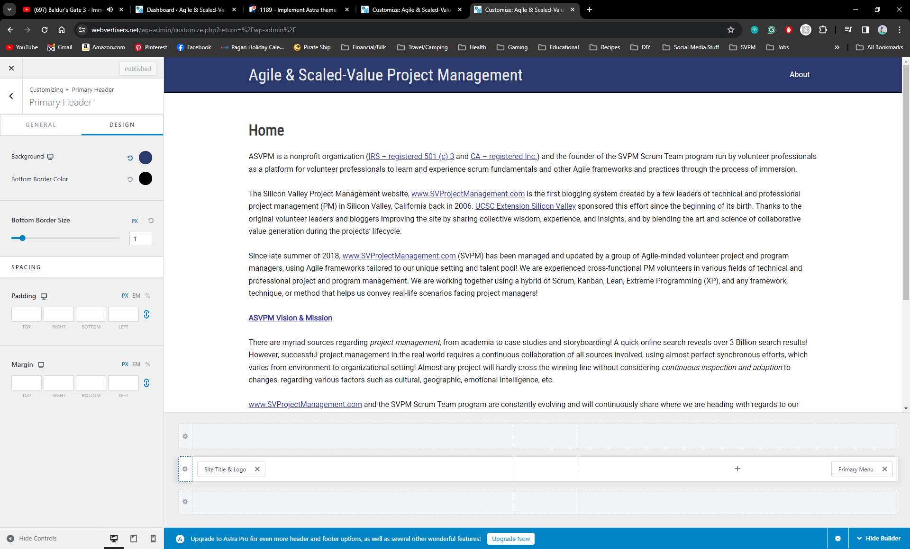
Primary Header & Logo Sections
I logged into the editor on svprojectmanagement.com and copied the colors, fonts, formatting, etc. to ensure the designs were cohesive so that the header & footer would look like this :
You are going to start by selecting Primary Header. Click on the header space and it will pull up the edit selections:
Next you are going to select the logo
General
Height: 70px
We will not be changing the general settings
Design
Logo Color: E9EAEB
Title Color: Normal - E9EAEB Hover - E9EAEB
Tagline: E9EAEB
Title Font Size: 35
Design
Background: 2A3A6C
Bottom Border Color: 000000
(Reminder – I pulled all colors & fonts from the SVPM site so that they match)

Slide 9
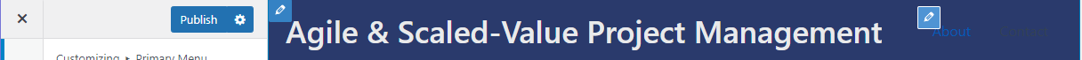
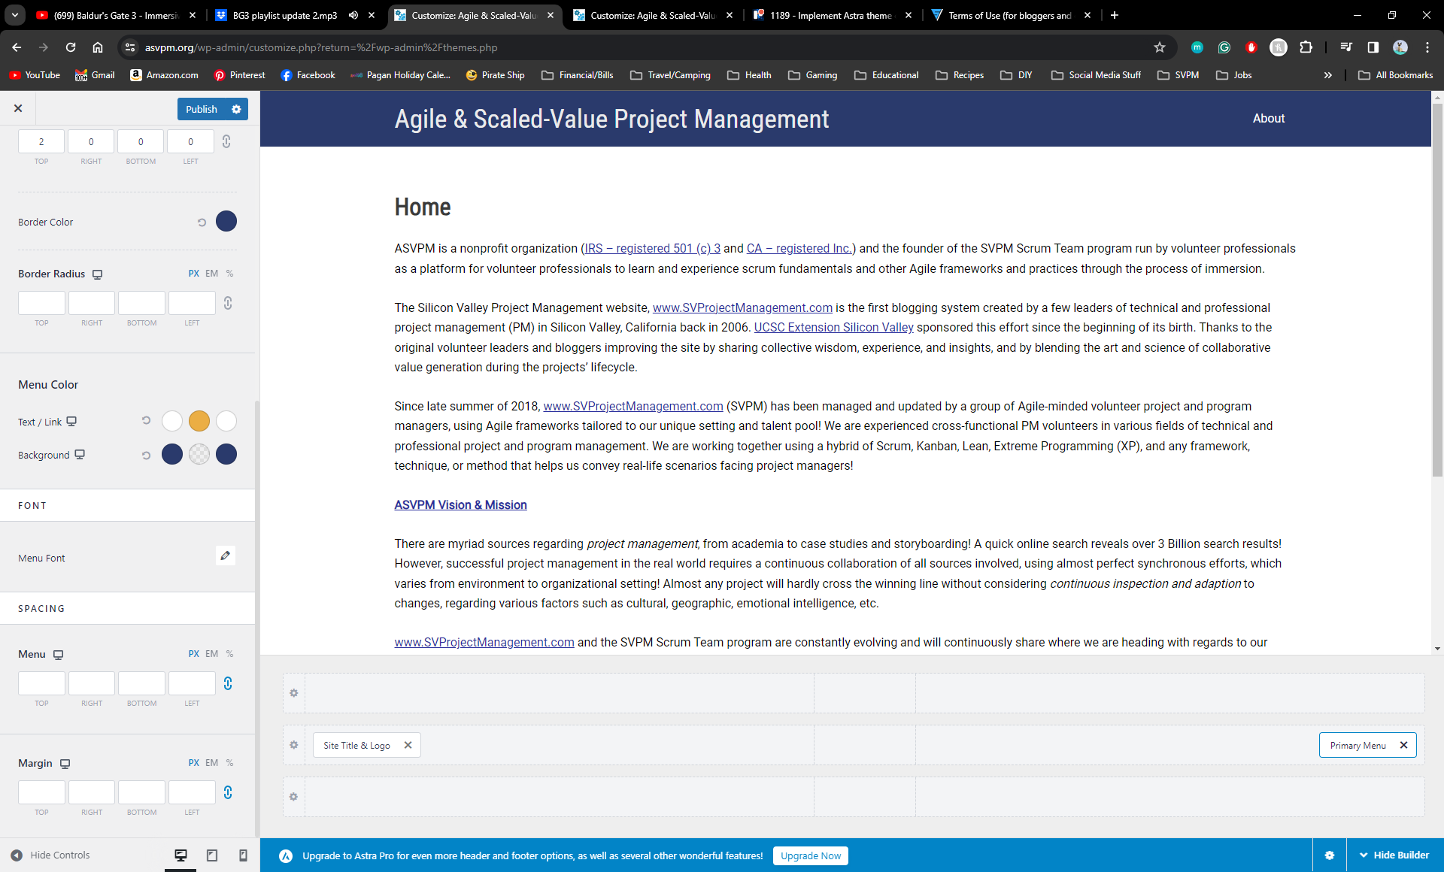
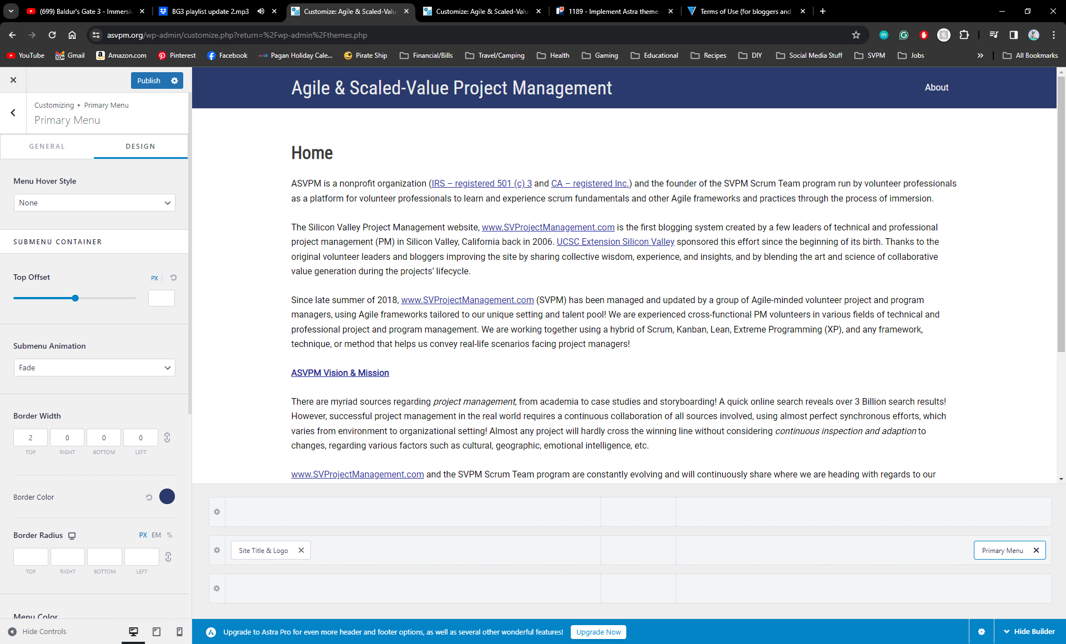
Primary Menu Section
Design
Submenu Animation: Fade
Border Color: 2A3A6C
Menu Color
Text/Link
Normal: FFFFFF
Hover: EBAE44
Active: FFFFFF
Background
Normal: 2A3A6C
Hover: 2A3A6B00
Active: 2A3A6C

Slide 10
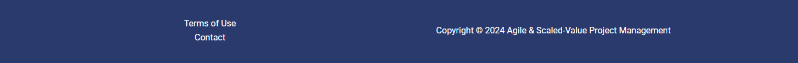
Footer
The footer should contain the organizational information such as terms of use and contact us like SVPM.
The footer should have one click access to terms of use, contact us, copyright information, and Follow Us information similar to SVPM.

Slide 11
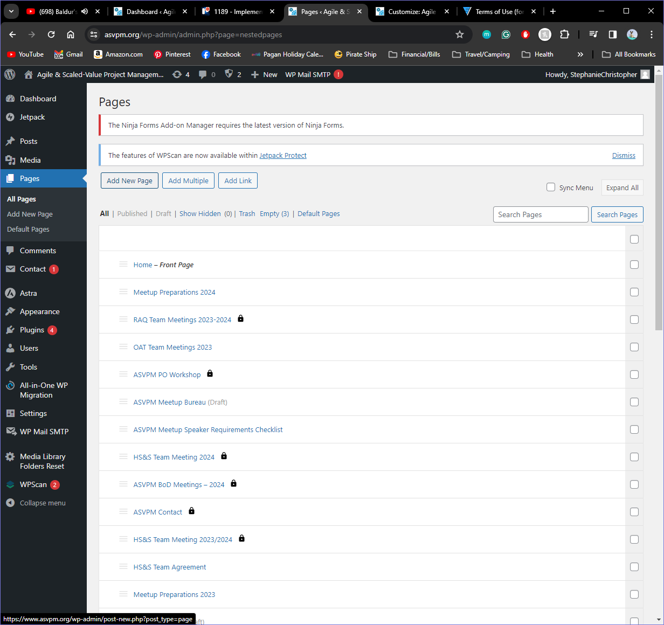
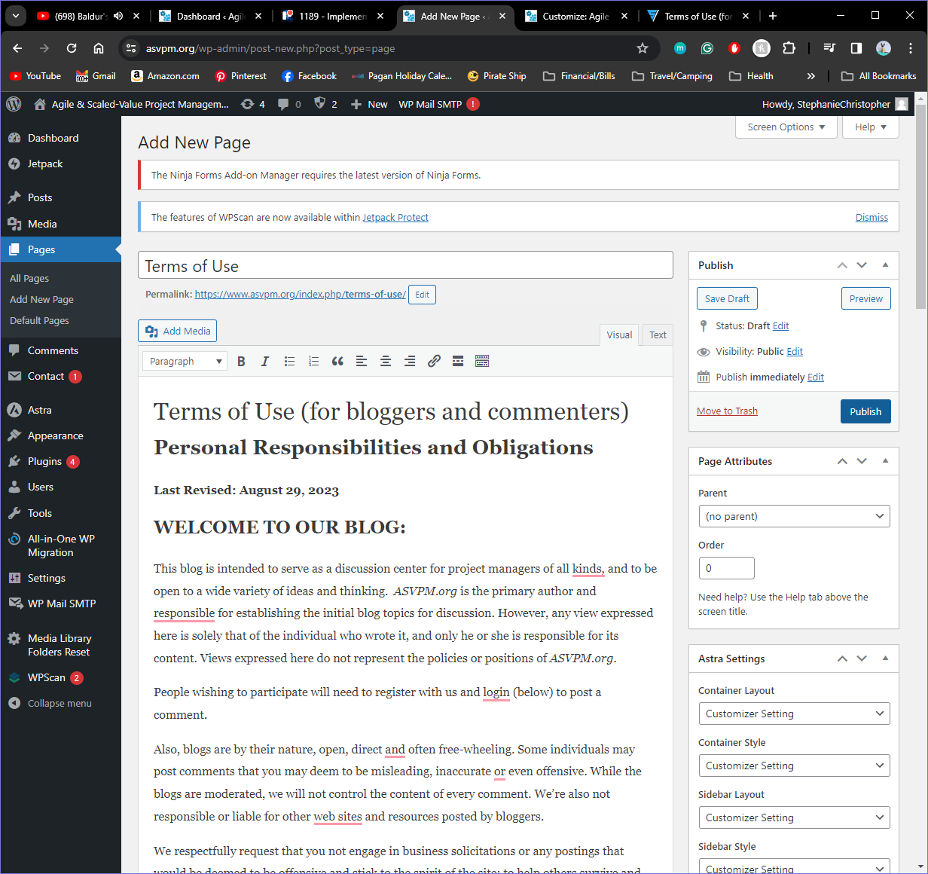
Prior to Starting on the Footer you will want to create a Terms of Use Page since one does not exist.
I created the page by going to the WordPress home screen and selecting pages from the menu
Then I created a new page and copied and pasted the Terms of Use from SVPM.
I ensured the page was named correctly and then published the page.
This allowed me to create a section for this in the footer menu (I will show in the next slide)

Slide 12
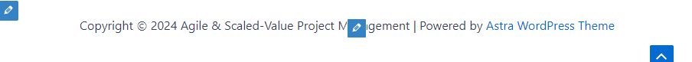
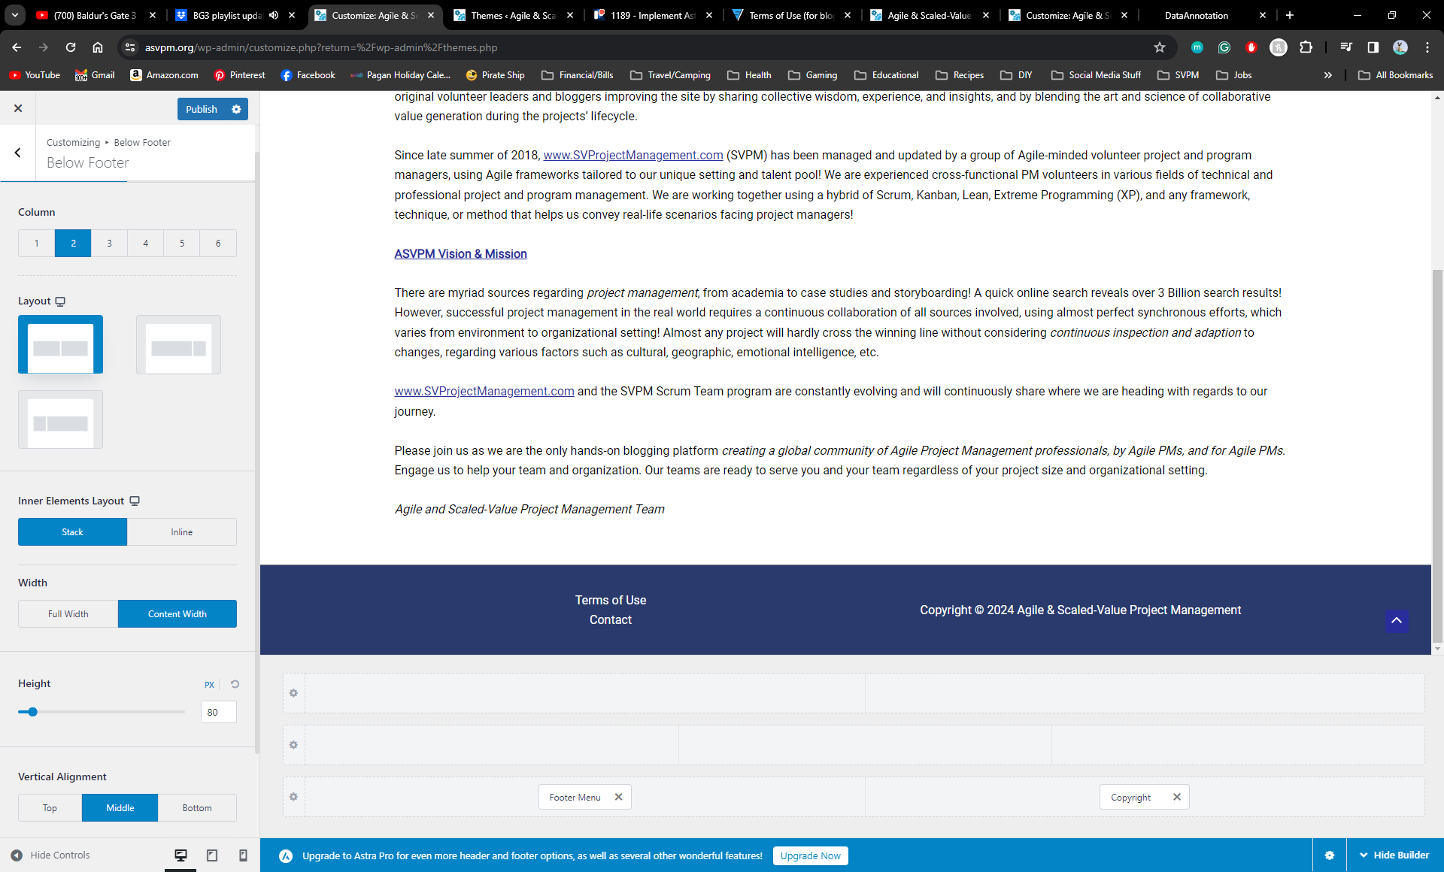
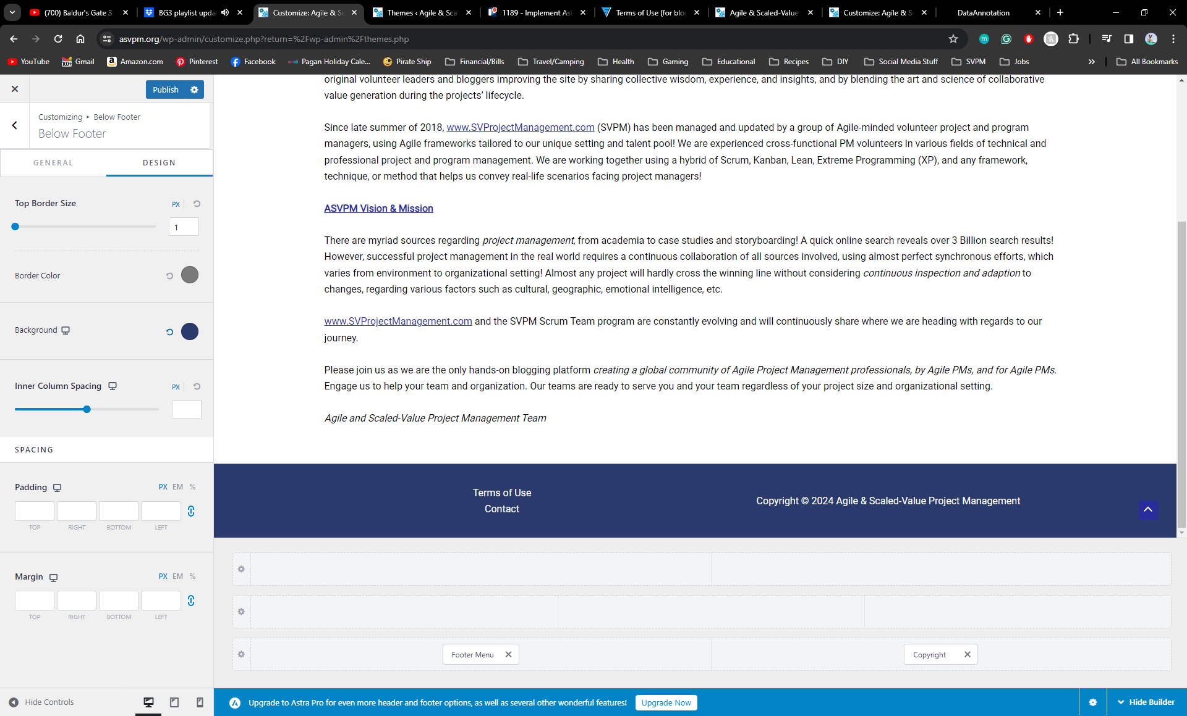
Below Footer
General
Column: 2
Vertical Alignment: Middle
Design
Border Color: 7A7A7A
Background: 2A3A6C

Slide 13
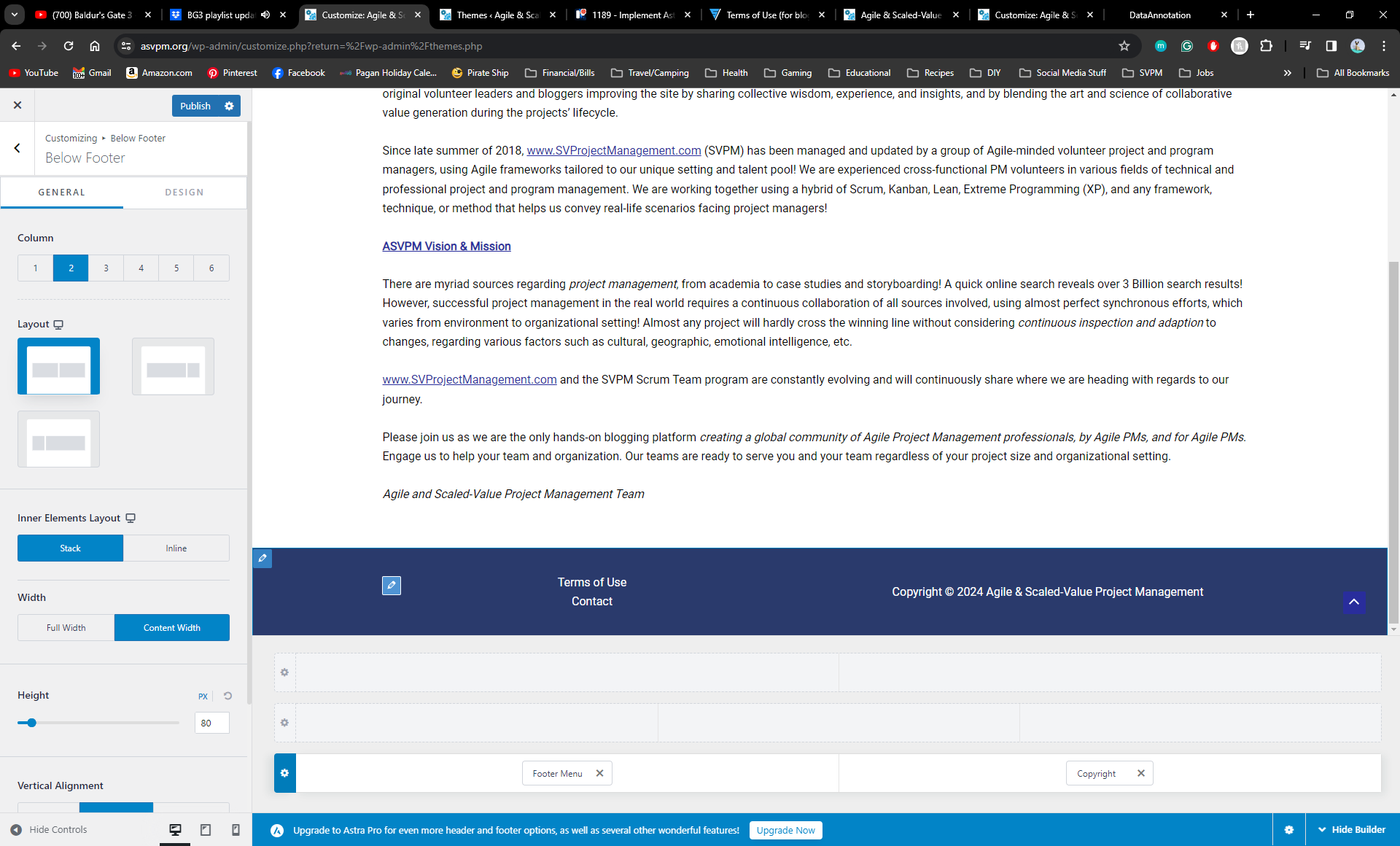

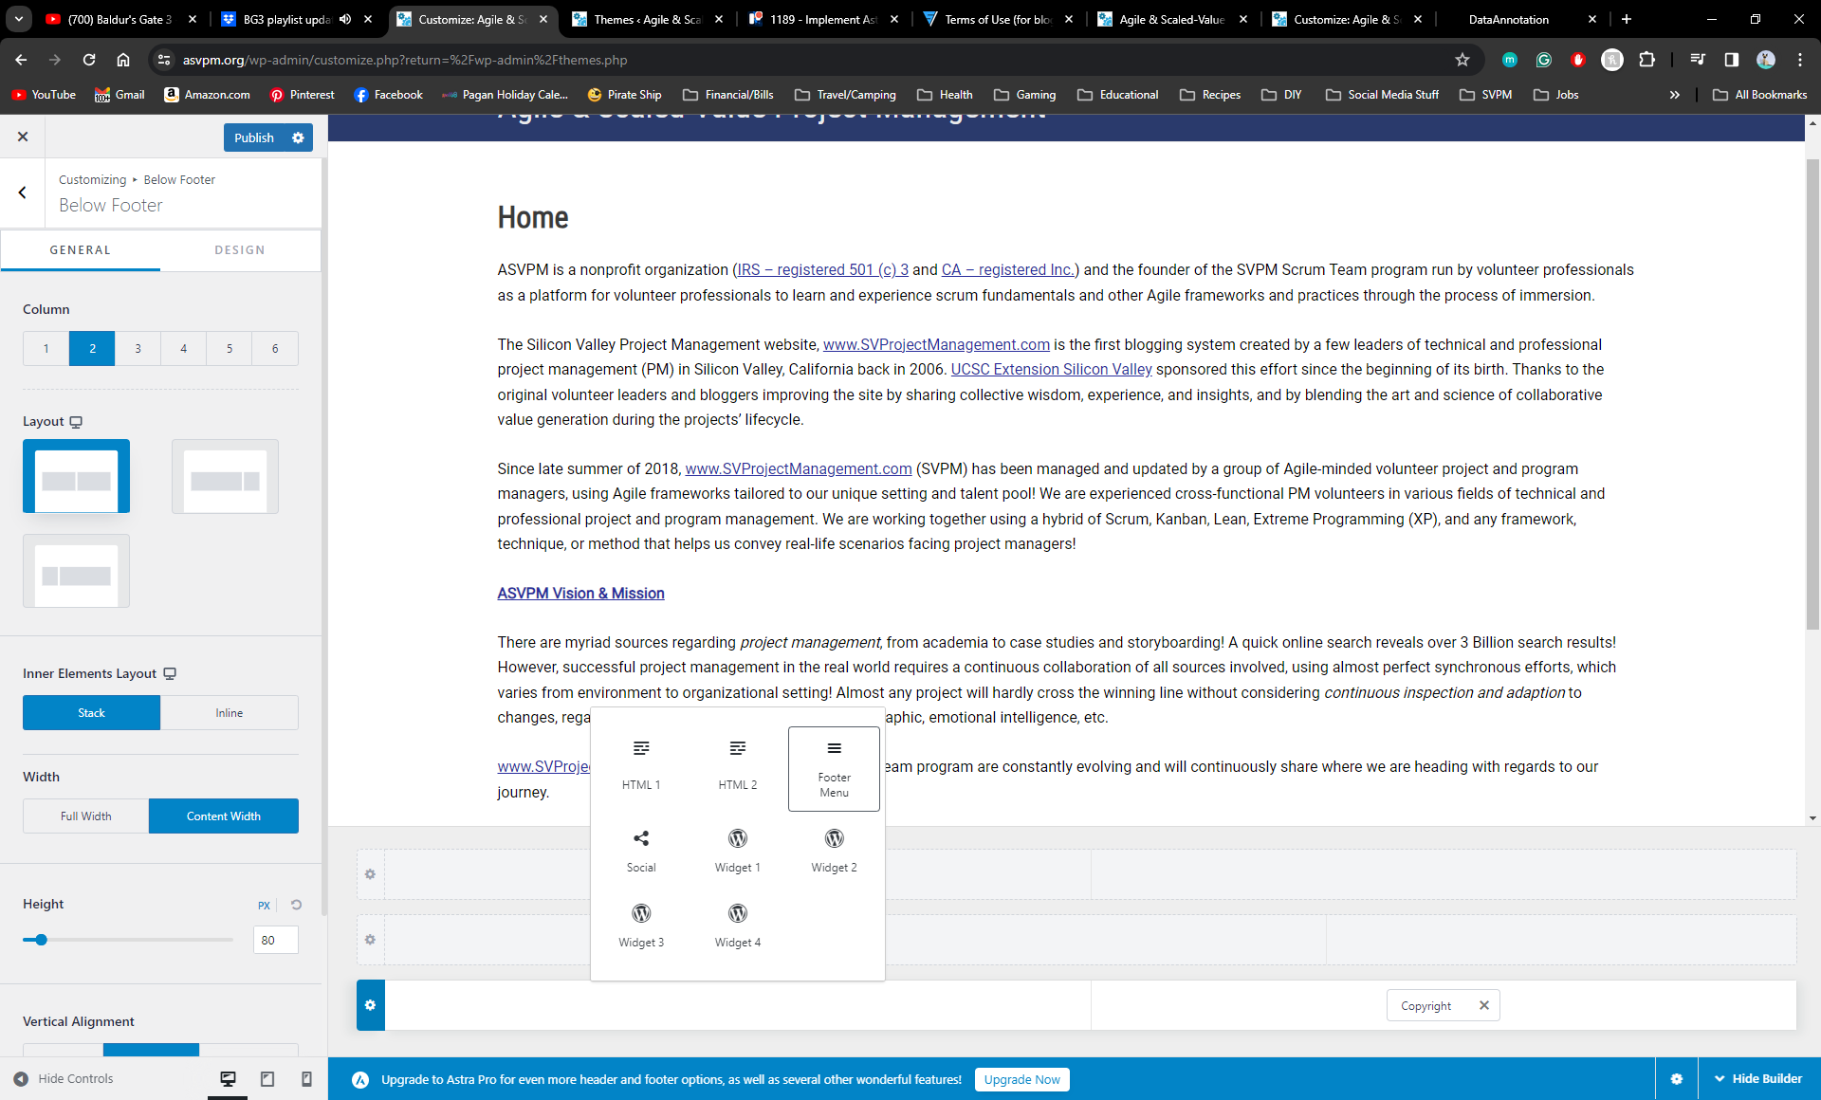
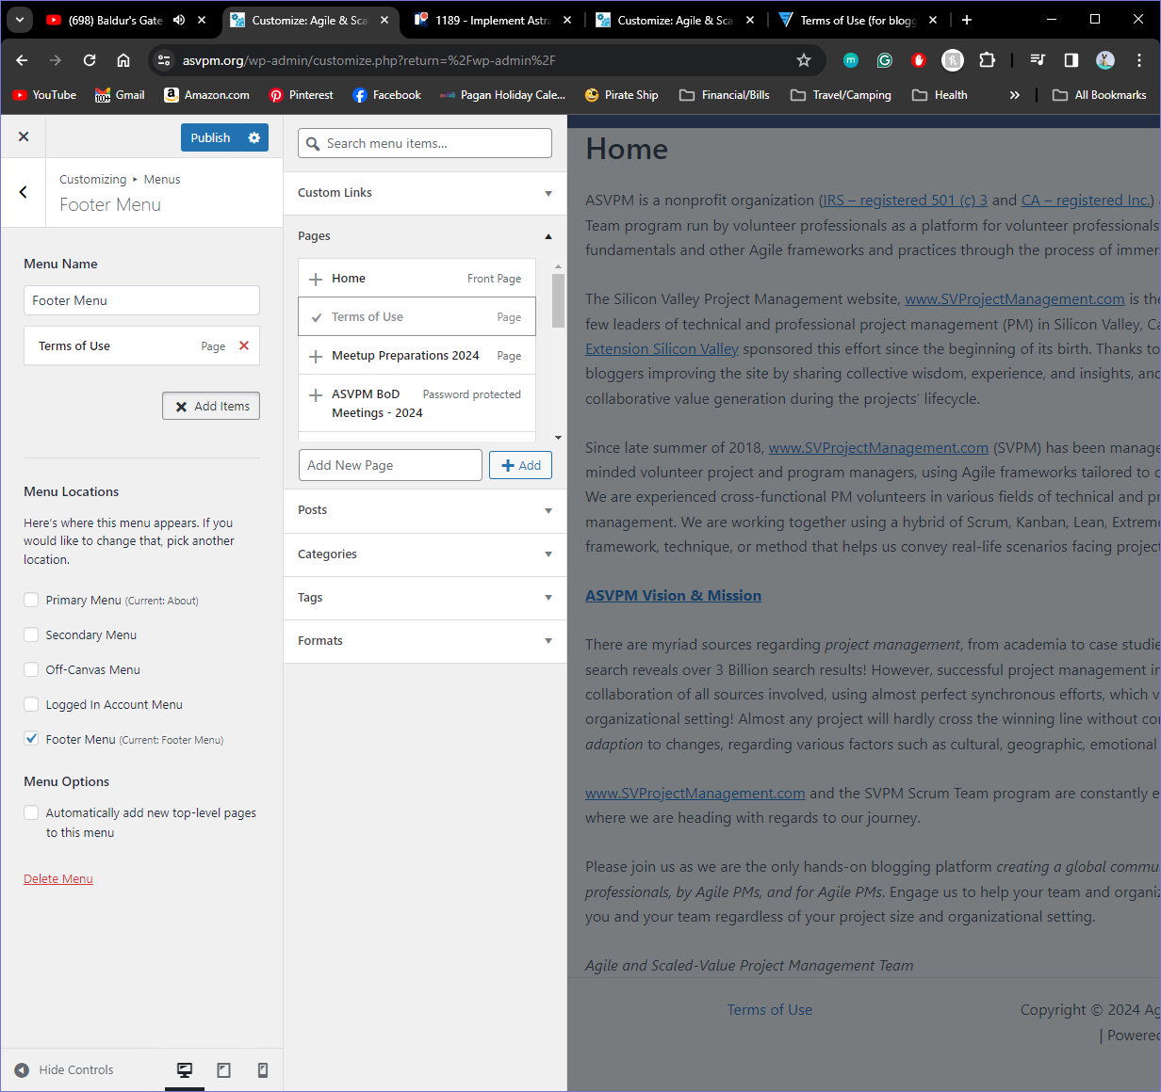
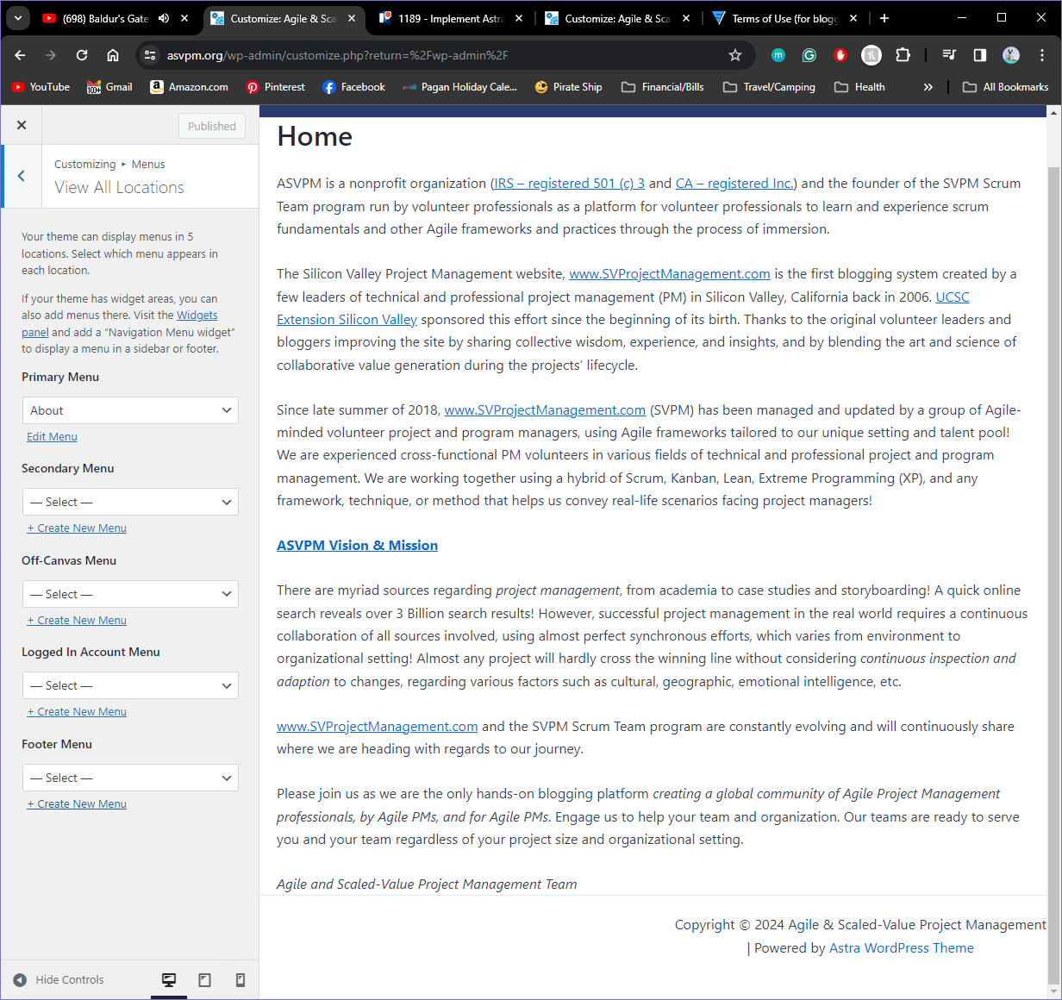
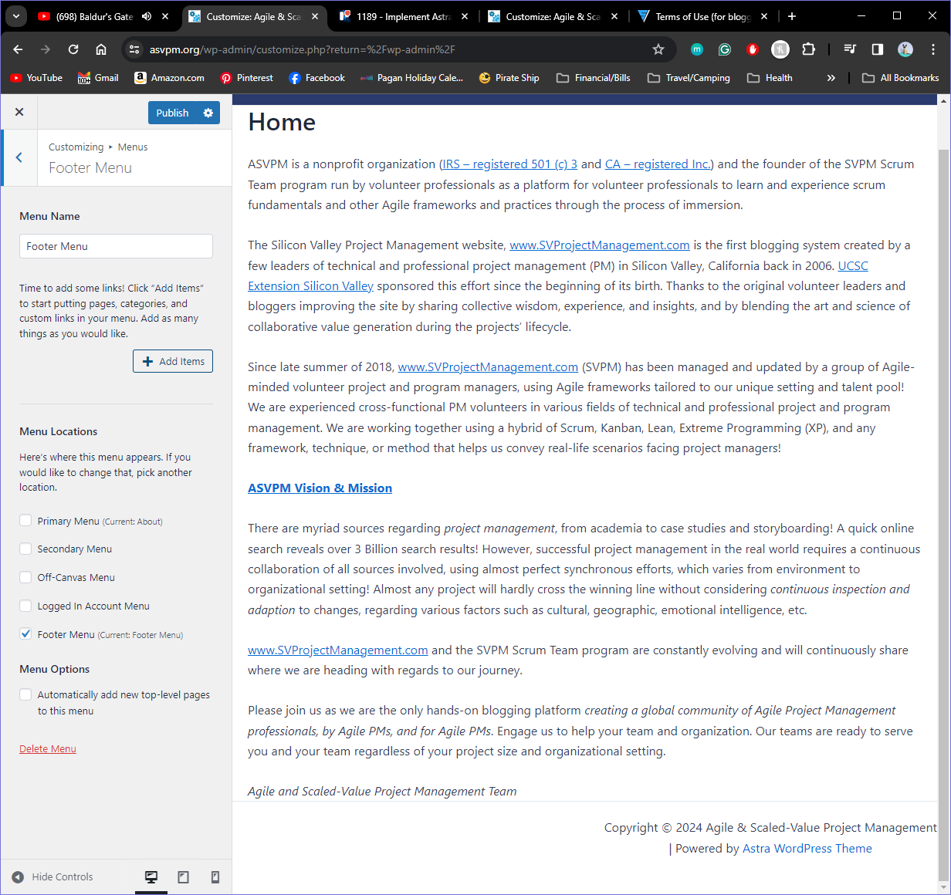
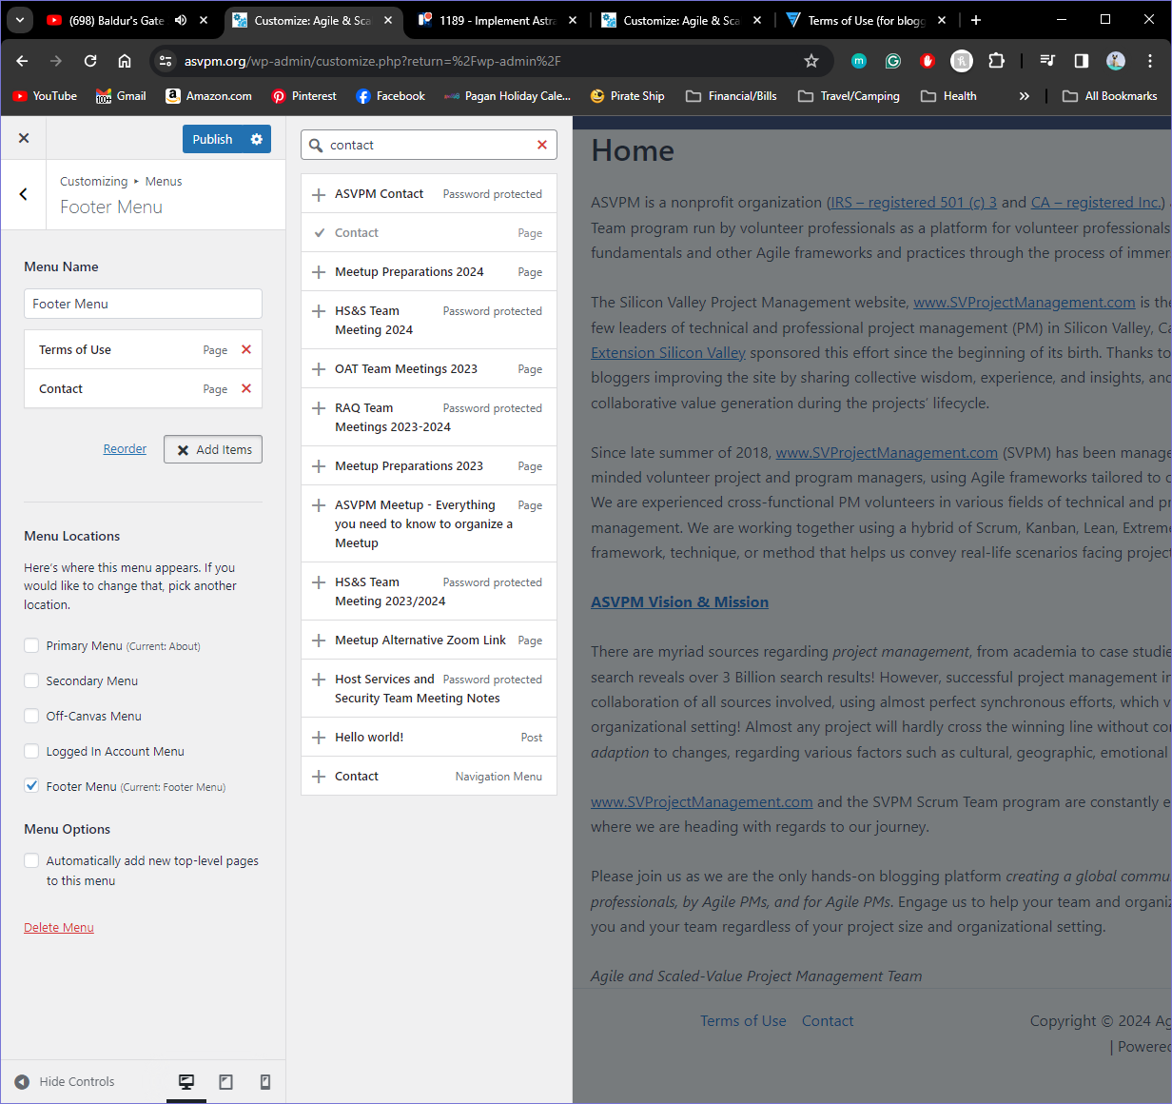
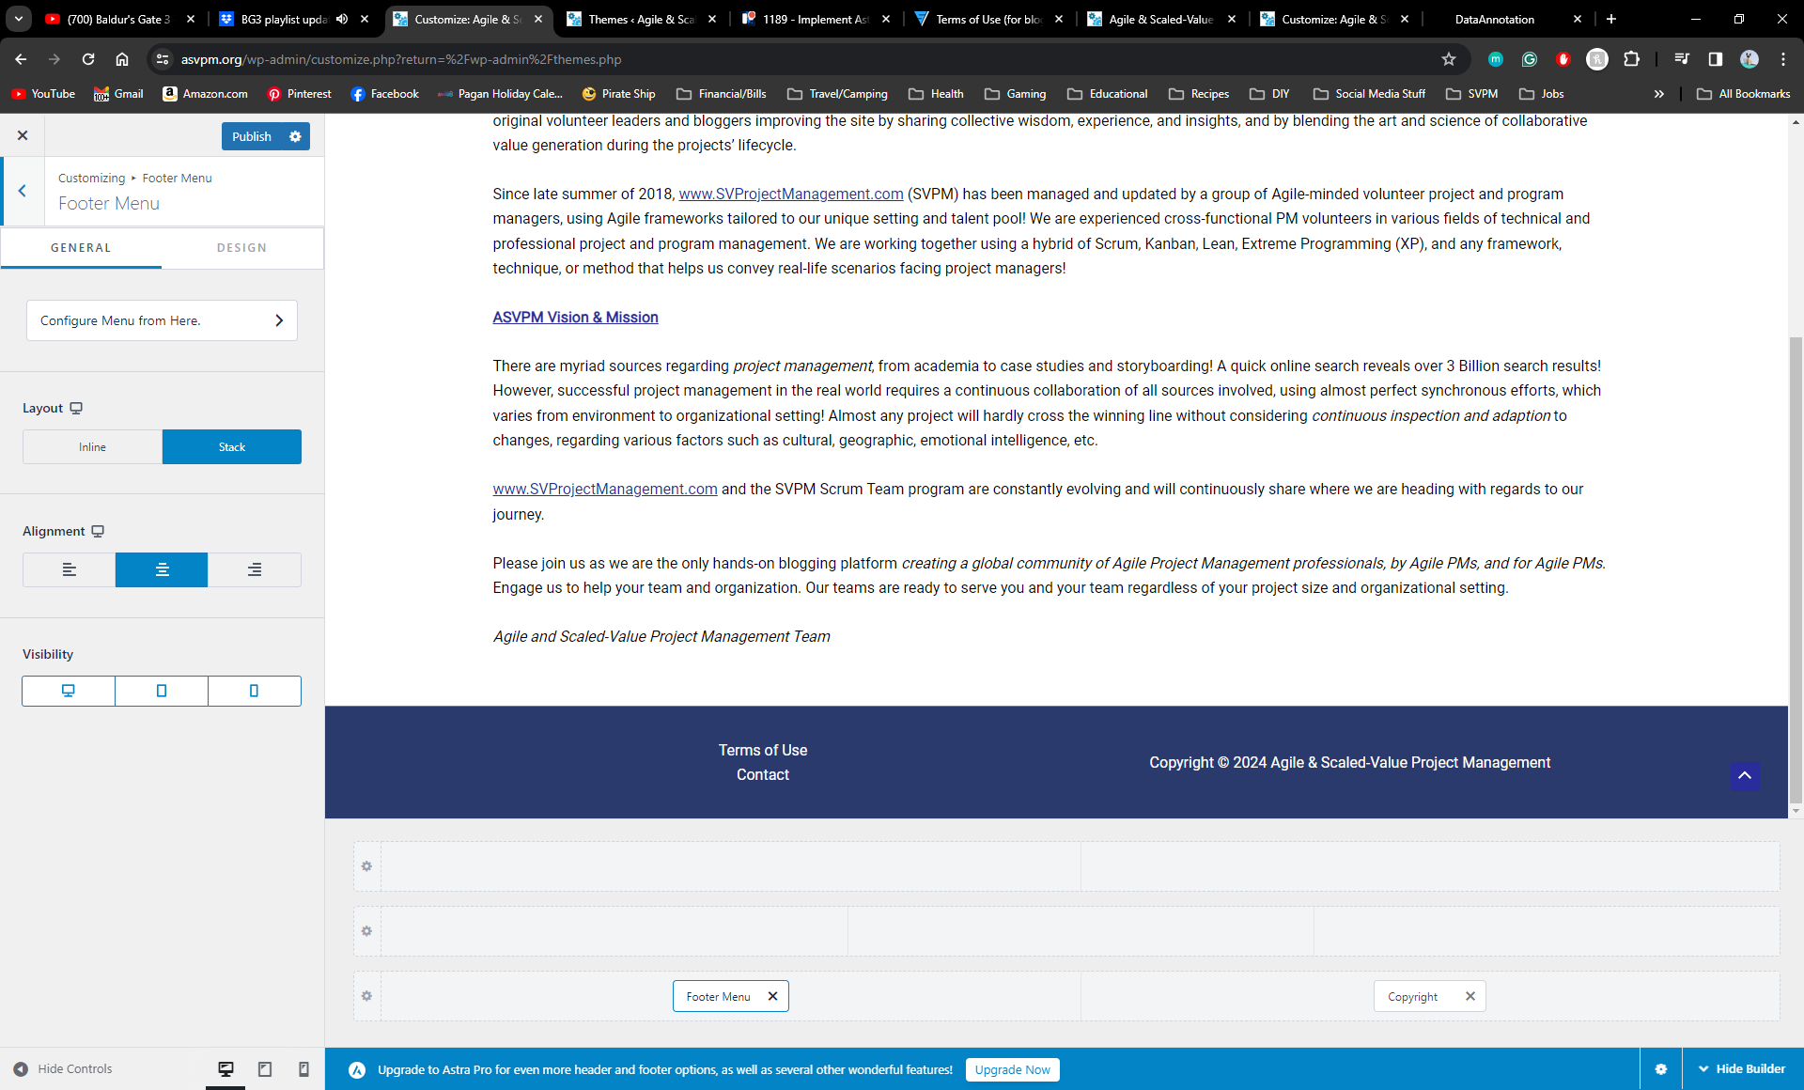
Footer Menu
Select the + symbol in the first column of the footer
Then Select Footer Menu from the list
Select Create New Menu
under Footer Menu
Open the Pages drop down
Name that Menu Footer Menu
Click Footer Menu to open the editor
Select Terms of Use
Select Contact (This page was already built)
Select Configure Menu from Here
Select Add Items

Slide 14
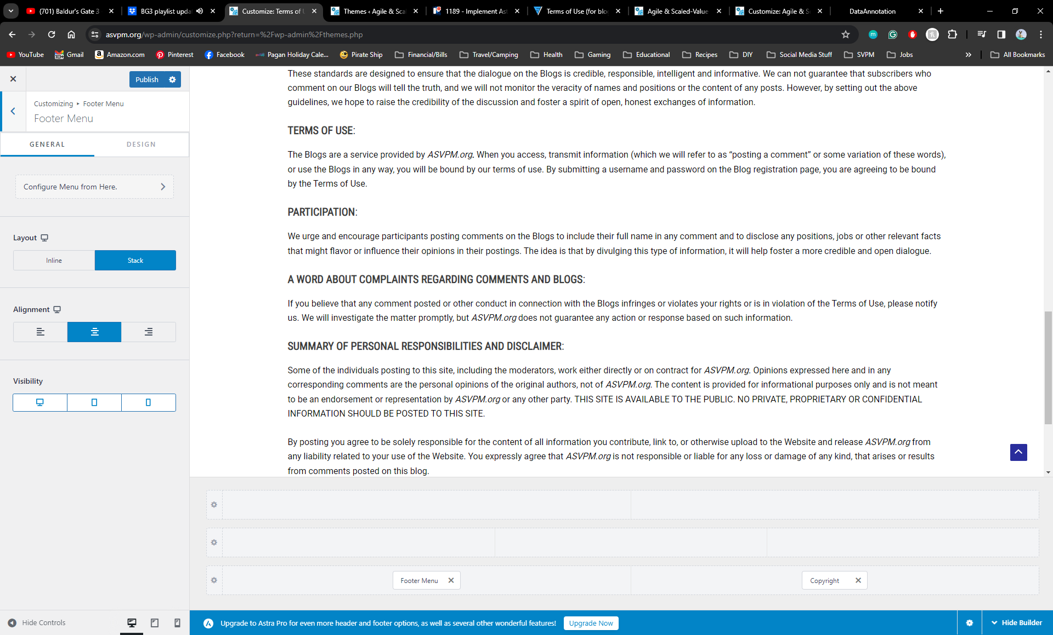

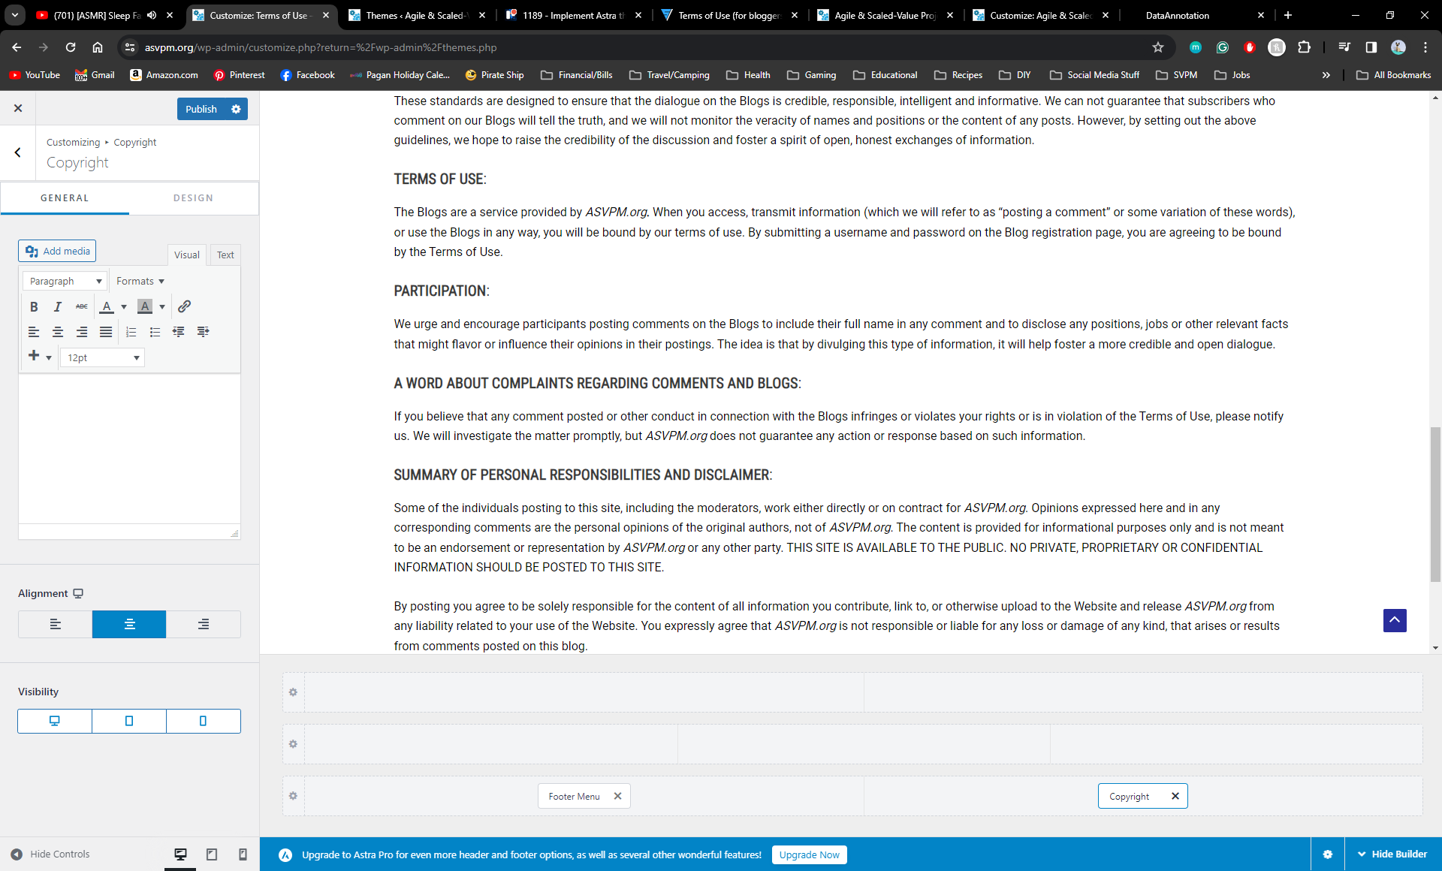
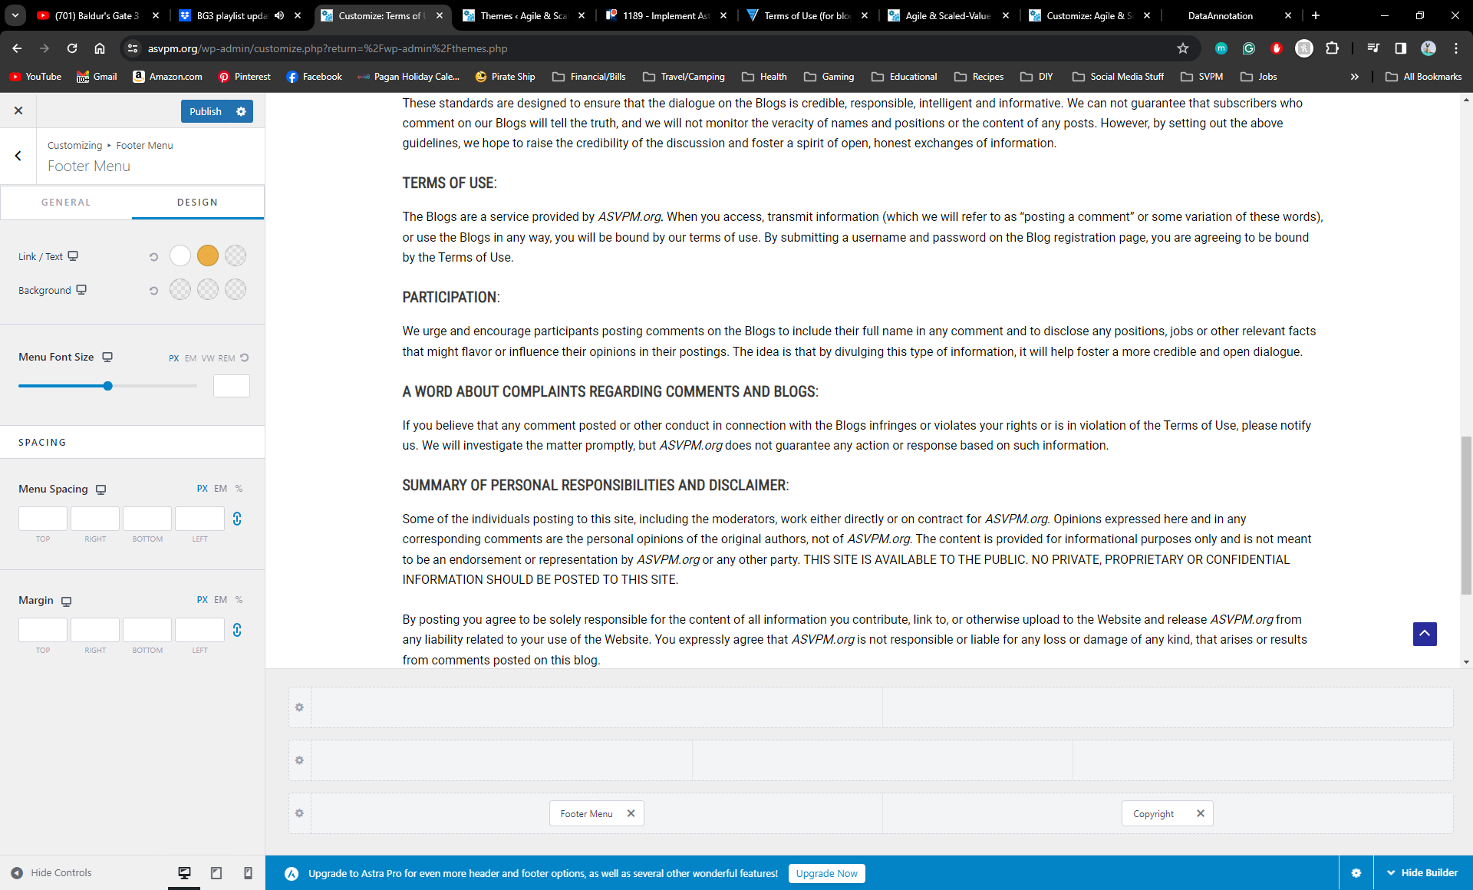
General
Layout: Stack
Alignment: Center
Select the Copyright Section of the Footer
Design
Link/ Text
Normal: FFFFFF
Hover: EBAE44
Active: 000000
Background
Normal: 000000
Hover: 000000
Active: 000000
General
Alignment: Center
Design
Text Color: FFFFFF
Don’t forget to click Publish to display all of your edits!

Slide 15
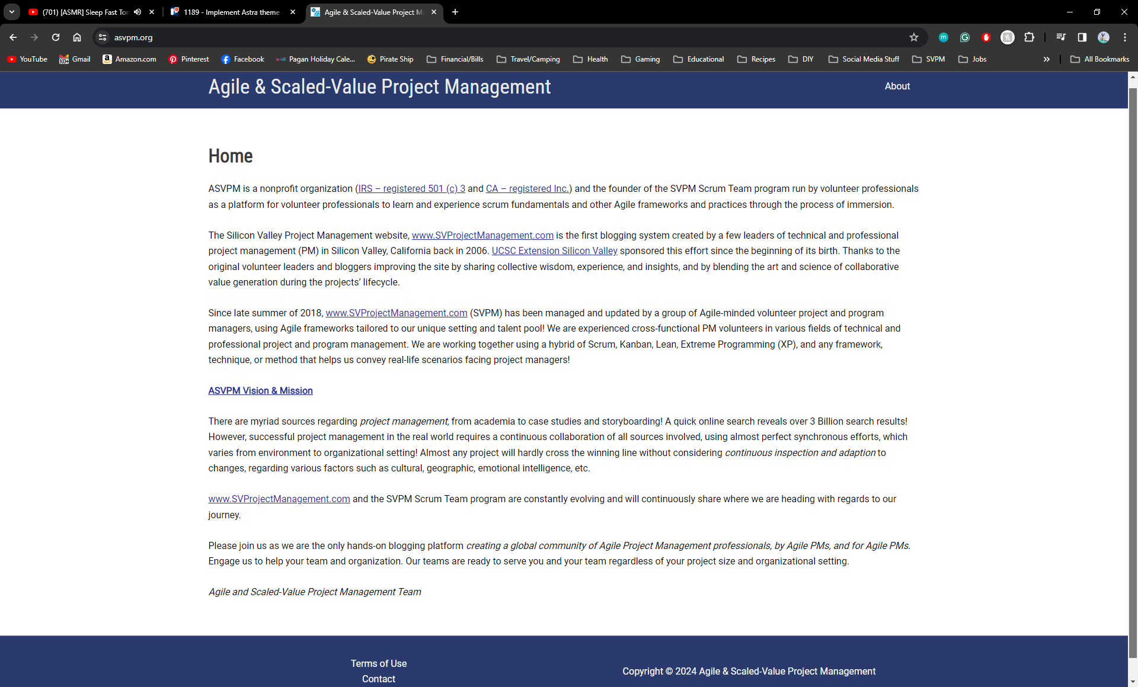
Finished Site

Slide 17
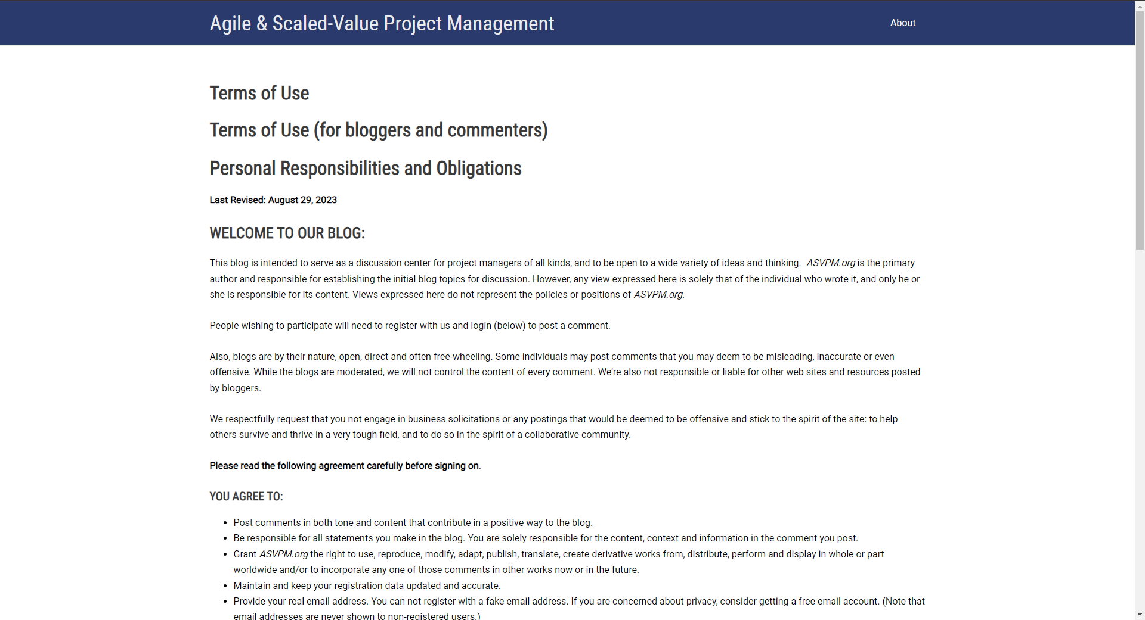

Slide 18
